Slide 1
Image Segmentation Def: Sub divides image into it constituent Regions

Slide 2
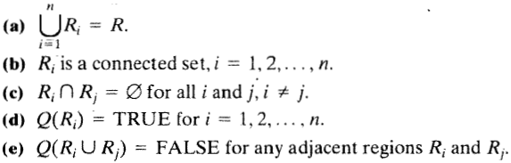
Segmentation Fundamentals
Let R represent the entire spatial region occupied by an image. The image segmentation is a process that partitions R into n sub regions, R1, R2, …. , Rn such that
Condition (a) indicates that the segmentation must be complete; that is, every pixel must be in a region.
Condition (b) requires that points in a region be connected in some predefined sense ( e.g., the points must be 4- or 8-connected).
Condition (c) indicates that the regions must be disjoint.
Condition ( d) deals with the properties that must be satisfied by the pixels in a segmented region for example, Q(Ri) = TRUE if all pixels in Ri have the same intensity level. Finally,
Condition ( e) indicates that two adjacent regions Ri and Rj must be different in the sense of predicate Q.

Slide 3
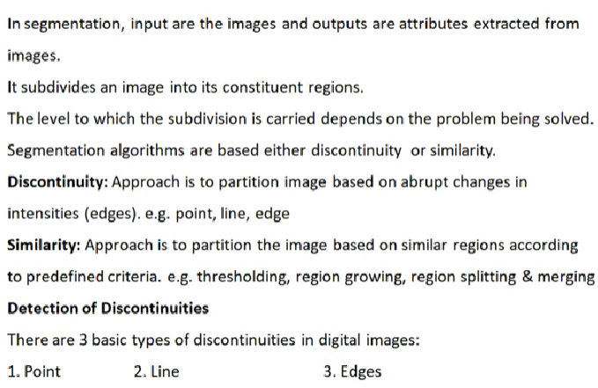

Slide 4
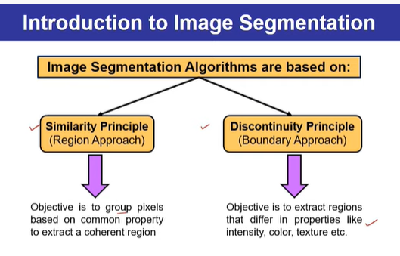
Principal approaches
Segmentation algorithms generally are based on one of 2 basic properties of intensity values.
Discontinuity : To partition an image based on sharp changes in intensity (such as edges).
Similarity : To partition an image into regions that are similar according to a set of predefined criteria. Ex: Thresholding, region growing, and region splitting and merging.

Slide 5
Detection of Discontinuities(Point ,Line and Edge detection)
The three types of image features are; isolated points, lines, and edges.
Edge pixels are pixels at which the intensity of an image function changes abruptly, and edges (or edge segments) are sets of connected edge pixels .
Edge detectors are local image processing methods designed to detect edge pixels.
A line may be viewed as an edge segment in which the intensity of the background on either side of the line is either much higher or much lower than the intensity of the line pixels.
Similarly, an isolated point may be viewed as a line whose length and width are equal to one pixel.

Slide 6
Back ground
Since averaging(smoothing) is analogous to integration, and hence local changes in intensity can be detected using derivatives.
First and second order derivatives are particularly well suited for this purpose.
The derivatives of a digital function are defined in terms of differences.
Definition for a first derivative:
Must be zero in flat segments
Must be nonzero at the onset of a gray-level step or ramp; and
Must be nonzero along ramps.
A basic definition of the first-order derivative of a one-dimensional function f(x) is

Slide 7
Definition for a second derivative
Must be zero in flat areas;
Must be nonzero at the onset and end of a gray-level step or ramp;
Must be zero along ramps of constant slope.
A basic definition of the second-order derivative of a one-dimensional function f(x) is

Slide 8
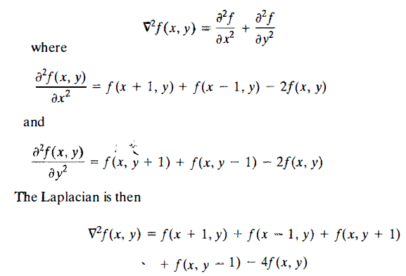
Detection of isolated points
We know that point detection can be done by using second derivative(Laplacian).
This expression can be implemented using the masks.

Slide 9
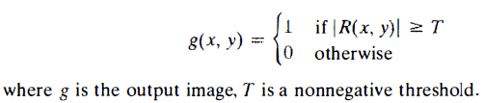
The output is obtained using the following expression:
T=90% of highest absolute pixel value

Slide 10
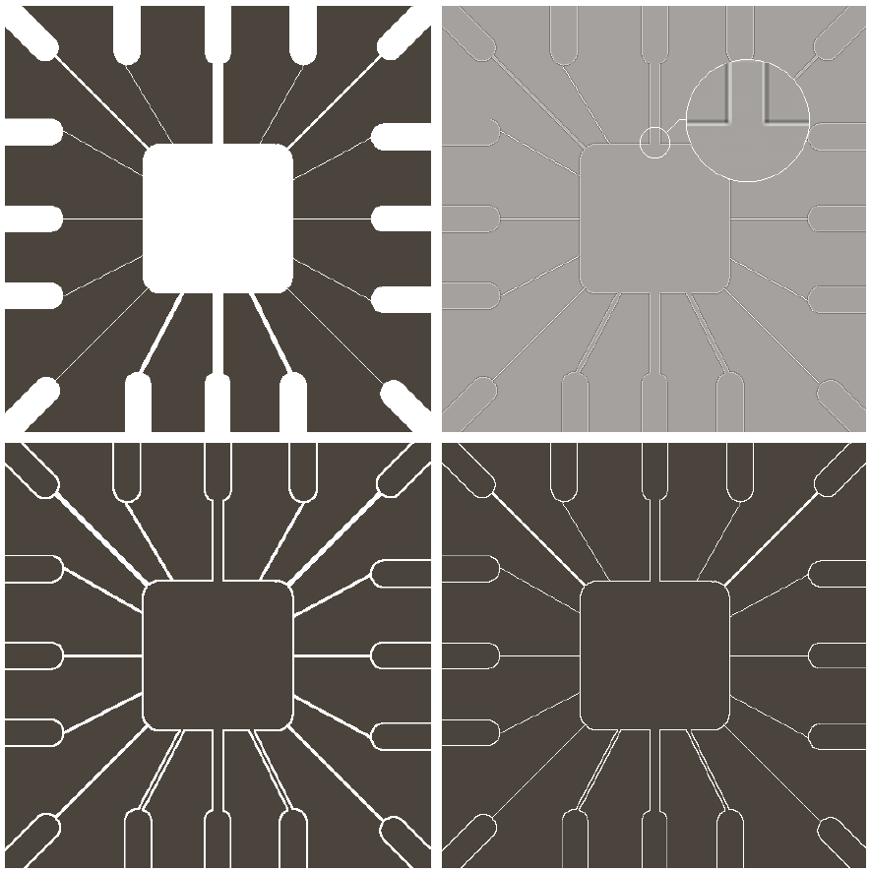
Line Detection
Second order derivative produces stronger response to lines and produce thinner lines compared to first order derivative . Hence Laplacian is also used for detecting lines.
Absolute value doubles the thickness of lines

Slide 11
In line detection, the assumption is that lines are thin with respect to the size of the detector.
The Laplacian detector in Fig. 10.4(a) is isotropic, so its response is independent of direction (with respect to the four directions of the 3 X 3 Laplacian mask: vertical, horizontal, and two diagonals).

Slide 12
Edge models
An edge is a set of connected pixels that lies on the boundary between two regions that differ in intensity values.
The pixels on the edge are called as edge points.
Some of the edges that are normally encountered in image processing are
Step edge
Ramp edge
Roof edge

Slide 13

Step edge: It is an abrupt change in intensity.
Ramp edge: It represents gradual change in intensity. The slope of ramp is inversely proportional to degree of blurring in the edge.
Roof edge: In this intensity change is not instantaneous but occur over a finite distance .

Slide 14
There are three fundamental steps performed in edge detection:
1.Image smoothing for noise reduction: Suppress as much noise as possible, without destroying true edges.
2.Detection of edge points: Determine which edge pixels should be discarded as noise and which should be retained.
3. Edge localization: Determine the exact location of an edge.

Slide 15
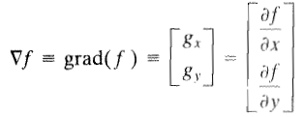
Basic Edge Detection
Image gradient and its properties
First derivatives in image processing are implemented using the magnitude of the gradient.
For a function f(x, y), the gradient of f at coordinates (x, y) is defined as the two-dimensional column vector
This vector points in the direction of greatest rate of change of f at
location(x,y).The magnitude of this vector is given by
It gives rate of change in the direction of gradient vector
(approximation)

Slide 16
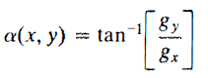
The direction of the gradient vector is given by the angle
It is measured with respect to the x-axis. The direction of an edge at an arbitrary point (x, y) is orthogonal to the direction, α(x, y), of the gradient vector at the point.

Slide 17
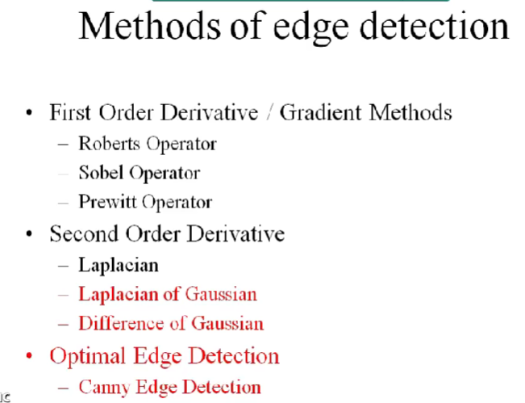

Slide 18
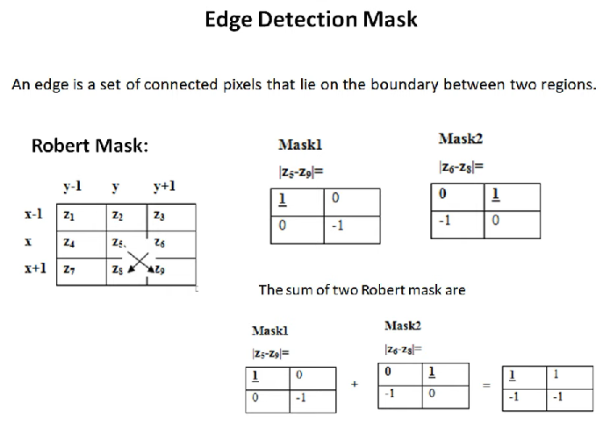

Slide 19
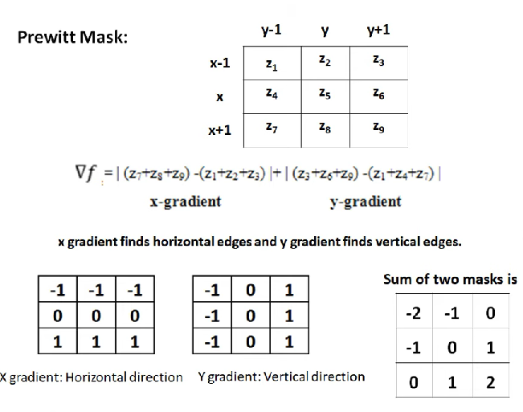

Slide 20
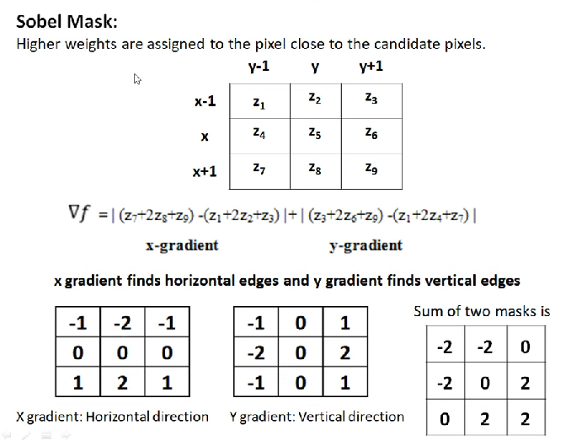

Slide 21
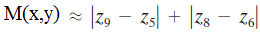
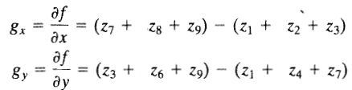
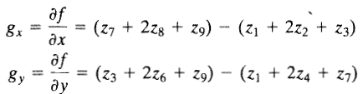
Calculation of g_{x}, g_{y} by the use of different operators:
Gradient operators
Roberts cross-gradient operators:
or
then
Masks of even size are not used to implement
because it does not have a center.
Prewitt operators
Sobel operators

Slide 22
Operators for detecting diagonal edges

Slide 23
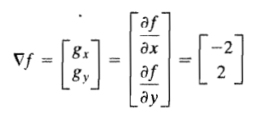
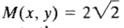

Slide 24
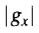
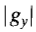
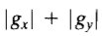

Slide 26
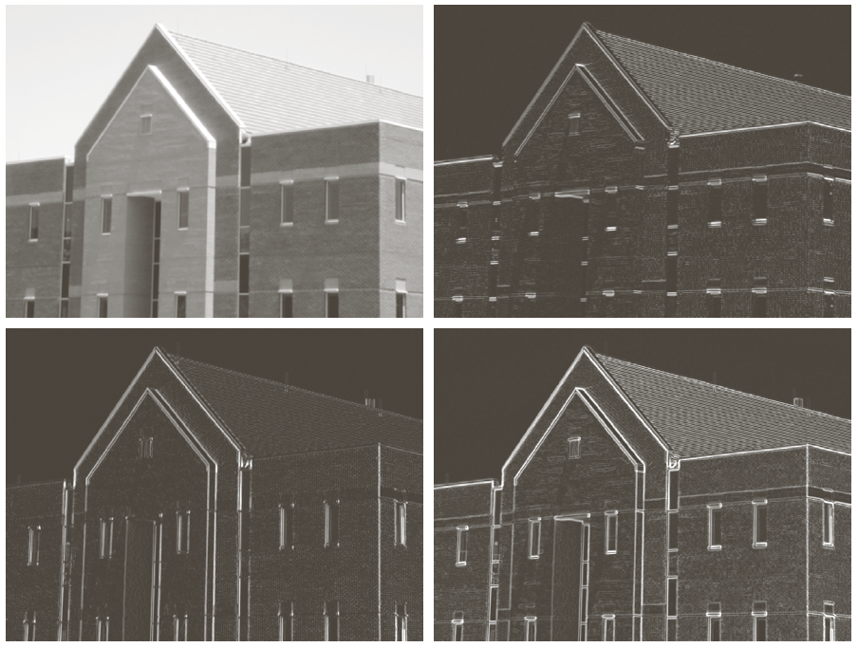
Image smoothed by 5x5 averaging filter

Slide 27
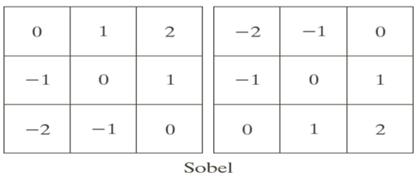

Slide 28
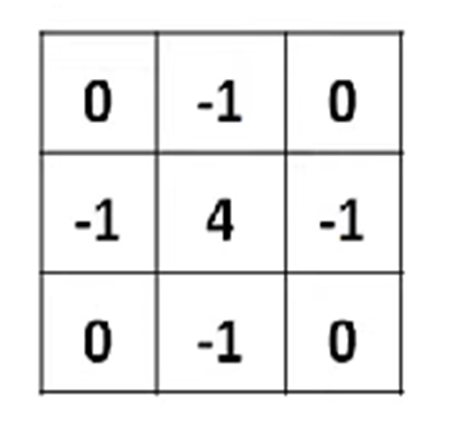
Detection of edges by Laplacian
We know that point detection can be done by using second derivative(Laplacian).
This expression can be implemented using the masks.

Slide 29
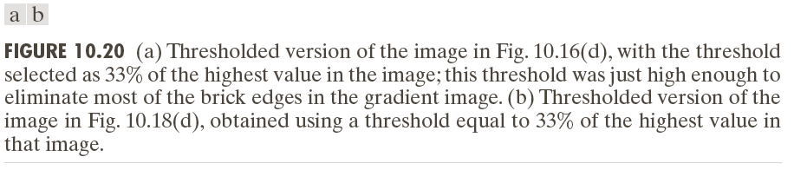
Combining the gradient with thresholding
Another approach for edge detection can be made more selective is to threshold the gradient image.
When thresholding used it produces fewer edges but these are more sharper compared with without thresholding. However, some of the edges are broken in thresholded image as shown in fig (a).
When interest lies both in highlighting the principal edges and on maintaining as much connectivity as possible, it is common practice to use both smoothing and thresholding as shown in fig (b)
Let Threshold value is 33% of maximum intensity value

Slide 30
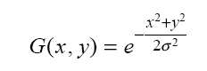
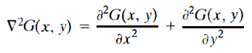
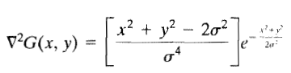
Advanced Edge detection by using Laplacian or Marr-Hildreth edge detector
To reduce the noise effect, the image is first smoothed.
When the filter chosen is a Gaussian, we call it the LoG (Laplacian of Gaussian)edge detector.
Let G is the 2-D Gaussian function then
Where σ is standard deviation which
controls smoothing
Now
This expression is called the Laplacian of a Gaussian (LoG ).Because of the shape ,the LoG function sometimes is called the Mexican hat operator.

Slide 31
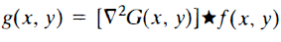
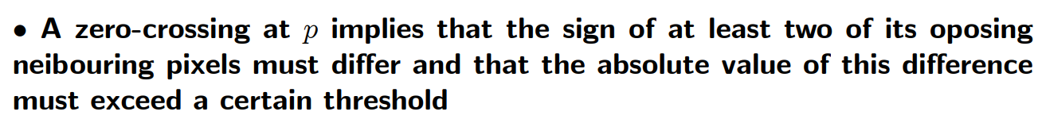
The Marr-Hildreth algorithm consists of convolving the LoG filter with an input image, f(x, y),
and then finding the zero crossings of g(x, y) to determine the locations of edges in f(x, y).
The Marr-Hildreth edge-detection algorithm :
Filter the input image with an n x n Gaussian lowpass filter.
Compute the Laplacian of the image resulting from Step 1.
Find the zero crossings of the image from Step 2.

Slide 32
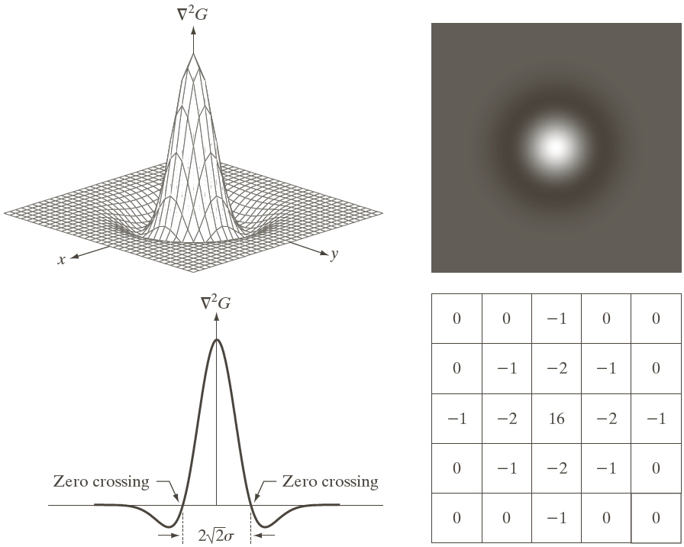
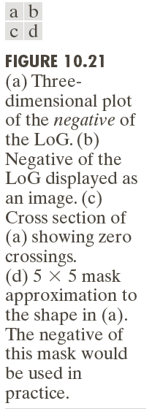

Slide 33
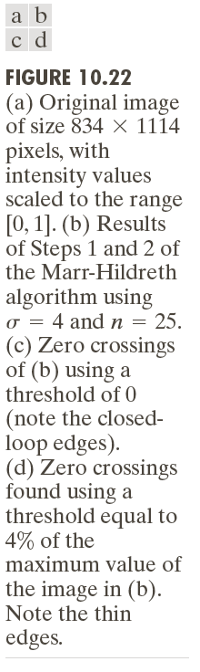

Slide 34
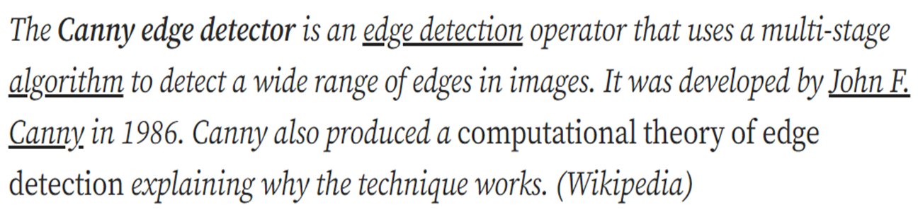
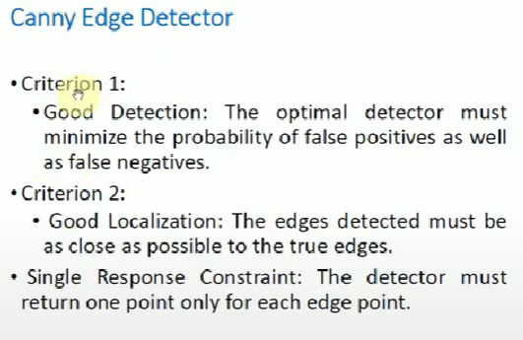
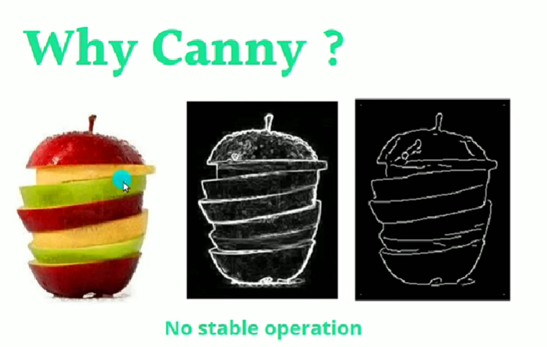
Canny Filter for Edge detection
***This Algorithm works on Gray scale images

Slide 35
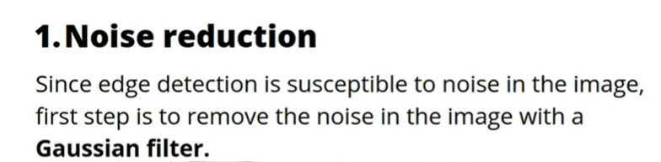
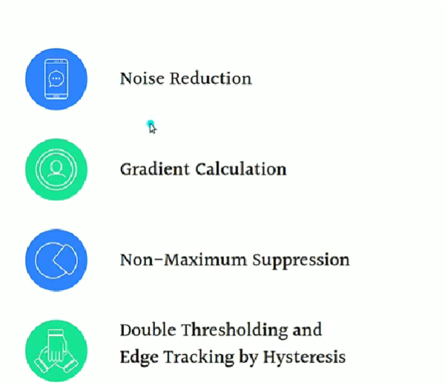
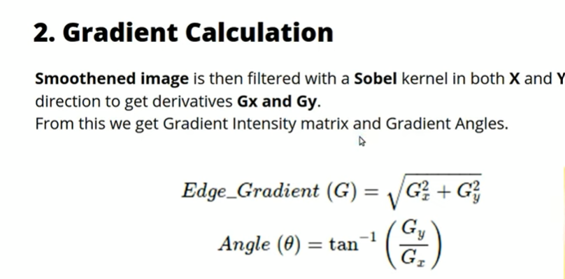
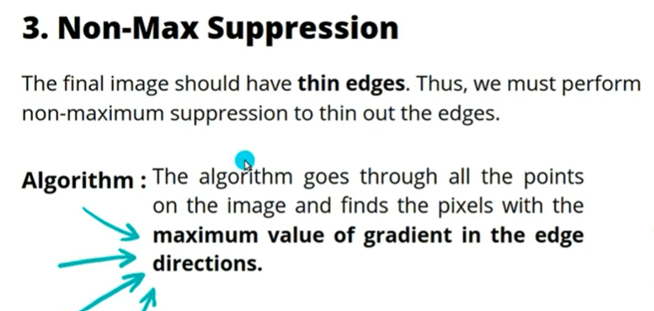
Procedure for Canny filters

Slide 36
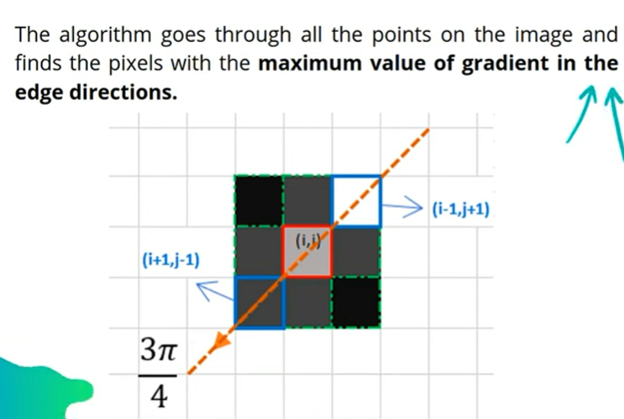
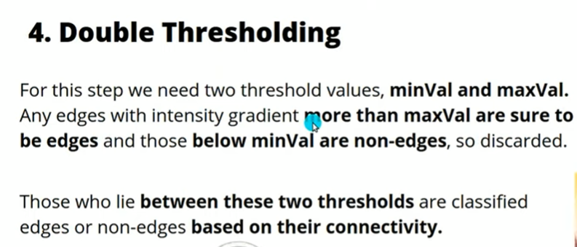
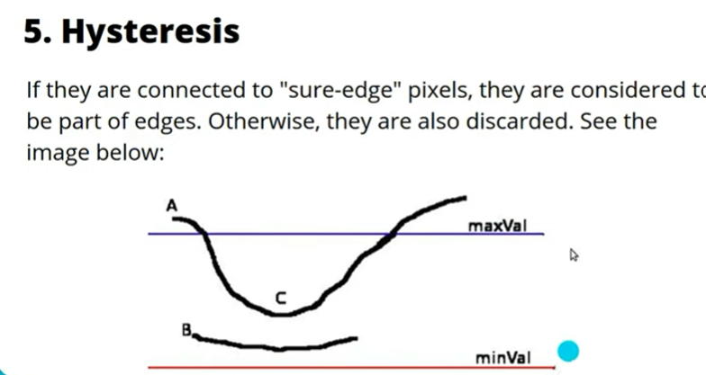
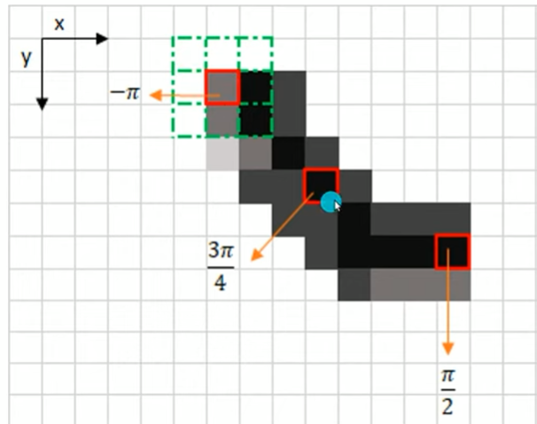

Slide 37
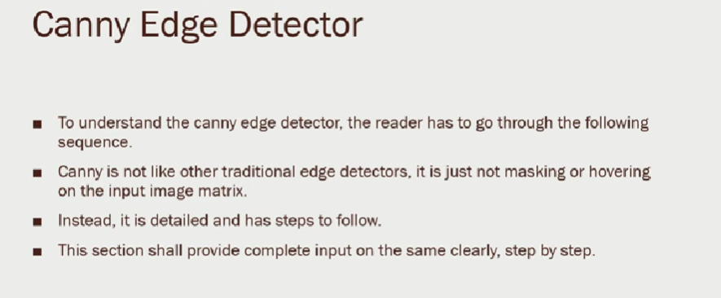

Slide 38
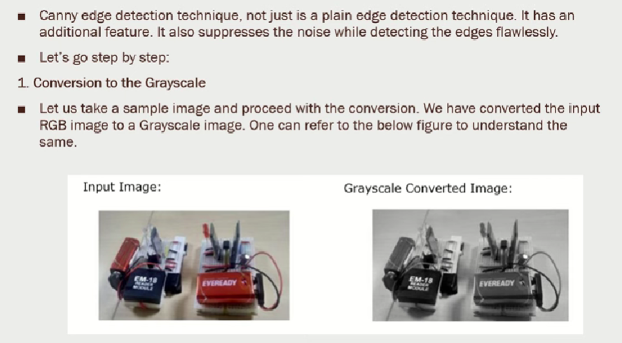

Slide 39
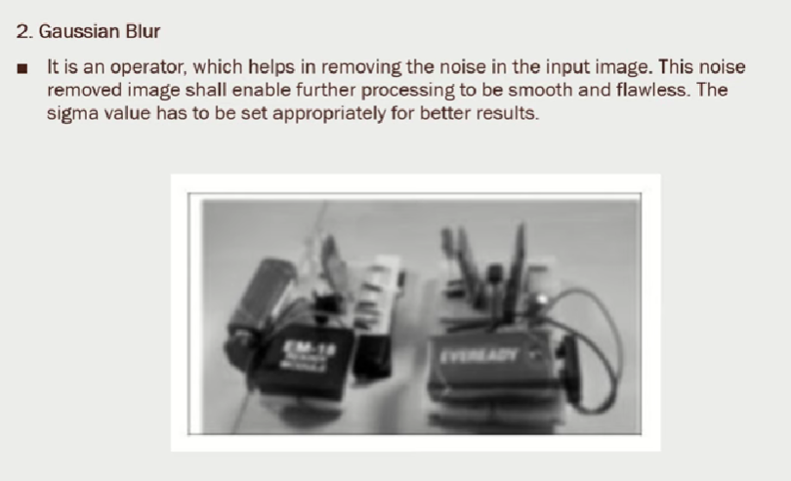

Slide 40
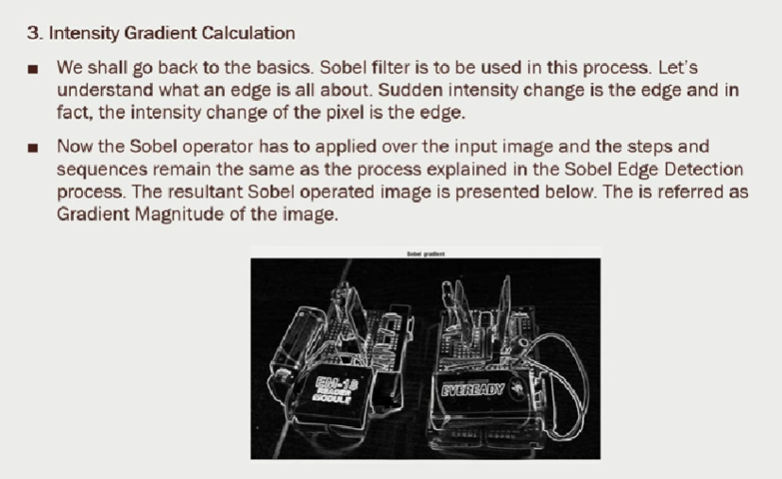

Slide 41
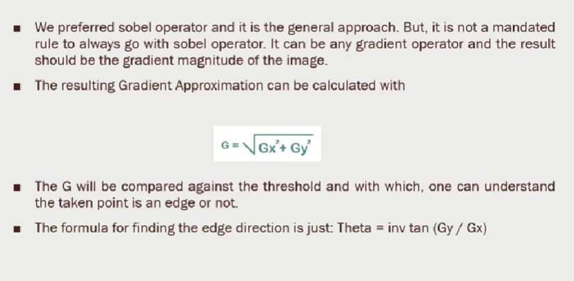

Slide 42
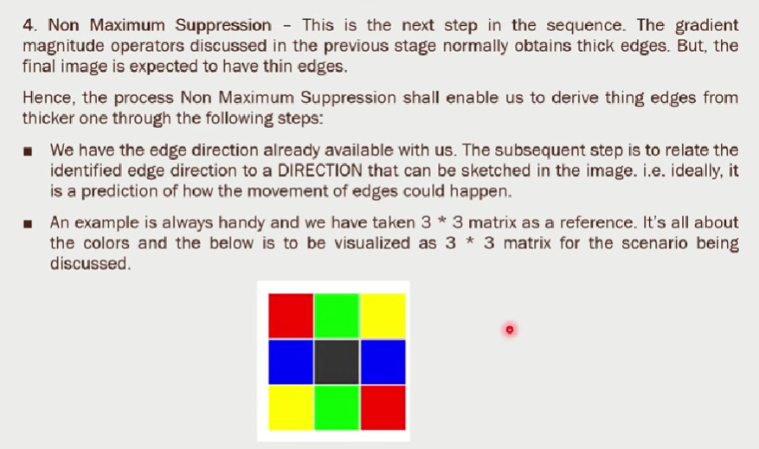

Slide 43
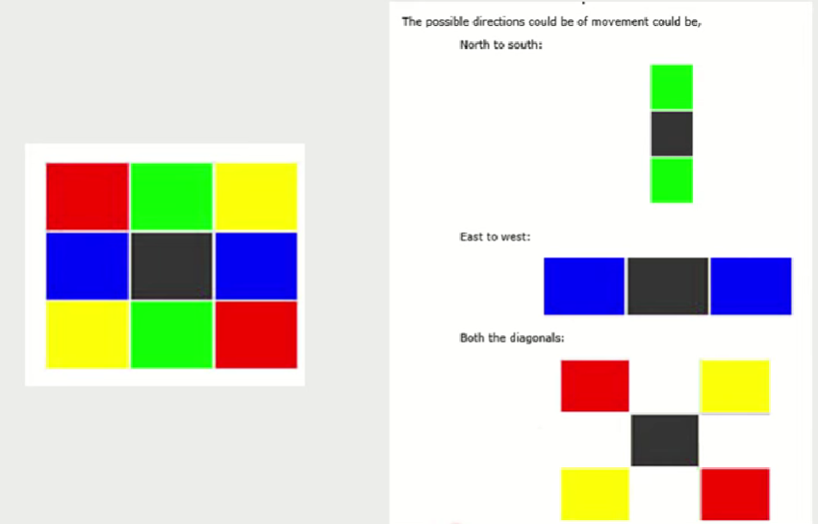

Slide 44


Slide 45


Slide 46


Slide 47


Slide 48


Slide 49


Problems

Slide 50





Slide 51


Slide 52




Slide 53




Slide 54



Slide 55




Slide 56
Edge Linking and Boundary Detection
Edge detection typically is followed by linking algorithms designed to assemble edge pixels into meaningful edges and/or region boundaries
Three approaches to edge linking
Local processing
Regional processing
Global processing

Slide 57
Local Processing
Analyze the characteristics of pixels in a small neighborhood about every point (x,y) that has been declared an edge point
All points that similar according to predefined criteria are linked, forming an edge of pixels.
Establishing similarity: (1) the strength (magnitude) and (2) the direction of the gradient vector.
A pixel with coordinates (s,t) in S_{xy} is linked to the pixel at (x,y) if both magnitude and direction criteria are satisfied.

Slide 58

Local Processing

Slide 59


Slide 60

Region processing ( Polygonization)

Slide 61
Global Processing Using the Hough Transform
“The Hough transform is a general technique for identifying the locations and orientations of certain types of features in a digital image. Developed by Paul Hough in 1962 and patented by IBM,
The transform consists of parameterizing a description of a feature at any given location in the original image’s space. A mesh in the space defined by these parameter is then generated, and at each mesh point a value is accumulated, indicating how well an object generated by the parameters defined at that point fits the given image.
Mesh points that accumulate relatively larger values then describe features that may be projected back onto the image, fitting to some degree the features actually present in the image.”

Slide 62



Hough Transform (transform image plane to parameter space)

Slide 63


Slide 64




Slide 67
Edge-linking Based on the Hough Transform
Obtain a binary edge image
Specify subdivisions in
Examine the counts of the accumulator cells for high pixel concentrations
Examine the relationship between pixels in chosen cell

Slide 68


Slide 69


Slide 70



Slide 71


Slide 72


Slide 73


Slide 74


Slide 75


Slide 76


Slide 77


Slide 78


Slide 79


Otsu Thresholding Numerical problem:
The algorithm will be demonstrated using the simple 6x6 image shown below. The histogram for the image is shown next to it. To simplify the explanation, only 6 greyscale levels are used.

Slide 80



Slide 81


Slide 82
Region based segmentation
These techniques are based on finding the regions directly.
(i) Region Growing
(ii) Region splitting and merging

Slide 83


Slide 84


Slide 85

Example –Region growing
In case of a region growing, the preferred rule can be set as a threshold.
For example: Consider a seed pixel of 2 in the given image and a threshold value of 3, if a pixel has a value greater than 3 then it will be considered inside the seed pixel region. Otherwise, it will be considered in another region.
Hence 2 regions are formed in the following image based on a threshold value of 3.
Condition : 8-Connectivity, absolute difference of pixel <=3

Slide 86



Slide 87


Slide 88


Slide 89


Slide 90

Region splitting
Region splitting is a top-down approach.
It begins with a whole image and divides it up such that the segregated parts are more homogenous than the whole.
Splitting alone is insufficient for reasonable segmentation, as it severely limits the shapes of segments. Hence, a merging phase after the splitting phase is always desirable, which is termed as the split-and-merge algorithm
Region Splitting and Merging
Region splitting and merging is an image-segmentation technique that takes spatial information into consideration. The region-splitting-and-merging method is as follows
Splitting:
The final partition is likely to contain adjacent regions with identical properties.
This drawback may be fixed by applying merging, and merging only adjacent regions whose combined pixels satisfy the predicate P.

Slide 91



Merging

Slide 92

Merging

Slide 93




Example- Split and merging

Slide 94





Slide 95


Slide 96
Segmentation by Morphological Watersheds
The concept of watersheds is based on visualizing an image in three dimensions: two spatial coordinates versus gray levels.
In such a topographic interpretation, we consider three types of points:
(a) points belonging to a regional minimum
-- (b) points at which a drop of water would fall to a single minimum (The catchment basin or watershed of that minimum) .
-- (c) points at which water would be equally likely to fall to more than one such minimum(The divide lines or watershed lines) .
The principal objective of segmentation algorithms based on these concepts is to find the watershed lines.

Slide 97


Slide 98
The idea is simple:
▪Suppose that a hole is punched in each regional minimum and that the entire topography is flooded from below by letting water rise through the holes at a uniform rate.
▪When rising water in distinct catchment basins is about the merge, a dam is built to prevent merging. These dam boundaries correspond to the watershed lines.

Slide 99

Illustration
Objective: finding the watershed lines.
In topographic view. in which the height of the "mountains’’ is proportional to gray-level values in the input image.
we imagine the perimeter of the entire topography (image) being enclose d by dams of height greater than the highest possible mountain, whose value is determined by the highest possible gray- level value in the input image.
Construction of dam to prevent catchment basins from merging.
Catchment basins
Watershed lines
Original image
Topographic view

Slide 101


Slide 102

(con’d)
Punch a hole in each regional minimal for water to fill up the catchment basin.

Slide 103

(con’d)
Water start merging, so shorter dam constructed
Longer dam constructed
Final result

Slide 104
One of the principal applications of watershed segmentation is in the extraction of nearly uniform objects from the background. Regions characterized by small variations in gray levels have small gradient values.
Thus in practice, we often see watershed segmentation applied to the gradient of an image, rather than to the image itself.

Slide 105
Watershed Segmentation Algorithm--
Starting with the notation:
g(x,y) is the image with min and max the lowest and highest graylevel, respectively
M₁, M₂, … M_{R} be the regional minima
T[n]={ (s,t) | g(s,t)<n }
C_{n}(M_{i}) is the set of (s,t) in the catchment basin of M_{i} that are flooded at stage n.
C[n-1] is a subset of C[n] and C[n] is subset of T[n]. So it implies that
Each connected component (CC) of C[n-1] is contained in exactly one CC of T[n].

Slide 106
Flooding
Initialization: C[min+1]=T[min+1]
Obtain C[n] from C[n-1] (recursively):
Let Q be the set of CC in T[n], and
3 possibilities for :
(a) empty
(b) containing one CC of C[n-1]
(c) containing more than one CC of C[n-1]

Slide 107
Constructing C[n]
Scenario (a) [empty]: a new minimum is found
q is incorporated into C[n-1] to form C[n]
Scenario (b) [containing 1 CC]: q lies in the catchment basin of some regional minimum
q is incorporated into C[n-1] to form C[n]
Scenario (c) [containing 1+ CC], part of the watershed line is encountered.
A dam must be build within q to prevent overflow between the catchment basins.

Slide 108

Dam Construction of height max+1
In C[n-1]
q
Scenario (c)

Slide 109


(con’d)
Dilate each CC of by the structuring element B,
subject to 2 conditions:
Dilation constrained to q (origin of B located in q)
Dilation cannot cause merging of CC’s being dilated
Change the height to max+1
B

Slide 110

Example
Gradient image
Segmented image

Slide 111
Types of Segmentation
Image segmentation modes are divided into three categories based on the amount and type of information that should be extracted from the image:
Instance:
Instance segmentation is a type of image segmentation that involves detecting and segmenting each object in an image.

Slide 112



Semantic: image segmentation that involves labeling each pixel in an image with a corresponding class label with no other information or context taken into consideration.
Panoptic: It is a combination of semantic and instance segmentation. It involves labeling each pixel with a class label and identifying each object instance in the image.

Slide 113
Segmentation : Traditional methods
Common traditional (or "classic") image segmentation techniques include:
Thresholding: Thresholding methods create binary images, classifying pixels based on whether their intensity is above or below a given “threshold value”. Otsu’s method is often used to determine the threshold value that minimizes intra-class variation.
Histograms: Histograms, which plot the frequency of certain pixel values in an image, are often used to define thresholds. For example, histograms can infer the values of background pixels, helping isolate object pixels.
Edge detection: Edge detection methods identify the boundaries of objects or classes by detecting discontinuities in brightness or contrast.
Watersheds: Watershed algorithms transform images into grayscale, then generate a topographical map in which each pixel’s “elevation” is determined by its brightness. Regions, boundaries and objects can be inferred from where “valleys”, “ridges” and “catchment basins” form.
Region-based segmentation: Starting with one or more “seed pixels”, region-growing algorithms group together neighboring pixels with similar characteristics. Algorithms can be agglomerative or divisive.
Clustering-based segmentation: An unsupervised learning method, clustering algorithms divide visual data into clusters of pixels with similar values. A common variant is K-means clustering, in which k is the number of clusters: pixel values are plotted as data points, and k random points are selected as center of a cluster (“centroid”). Each pixel is assigned to a cluster based on the nearest—that is, most similar—centroid. Centroids are then relocated to the mean of each cluster and the process is repeated, relocating centroids with each iteration until clusters have stabilized.

Slide 114
Deep learning image segmentation models
Prominent deep learning models used in image segmentation include:
Fully Convolutional Networks (FCNs): FCNs, often used for semantic segmentation, are a type of convolutional neural network (CNN) with no fixed layers. An encoder network passes visual input data through convolutional layers to extract features relevant to segmentation or classification, and compresses (or downsamples) this feature data to remove non-essential information. This compressed data is then fed into decoder layers, upsampling the extracted feature data to reconstruct the input image with segmentation masks.
U-Nets: U-Nets modify FCN architecture to reduce data loss during downsampling with skip connections, preserving greater detail by selectively bypassing some convolutional layers as information and gradients move through the neural network. Its name is derived from the shape of diagrams demonstrating the arrangement of its layers.
Deeplab: Like U-Nets, Deeplab is a modified FCN architecture. In addition to skip connections, it uses diluted (or “atrous”) convolution to yield larger output maps without necessitating additional computational power.
Mask R-CNNs: Mask R-CNNs are a leading model for instance segmentation. Mask R-CNNs combine a region proposal network (RPN) that generates bounding boxes for each potential instance with an FCN-based “mask head” that generates segmentation masks within each confirmed bounding box.
Transformers: inspired by the success of transformer models like GPT and BLOOM in natural language processing, new models like Vision Transformer (ViT) using attention mechanisms in place of convolutional layers have matched or exceeded CNN performance for computer vision tasks.

Slide 115

Image Segmentation Techniques
Traditional Techniques
Thresholding: the pixels are divided into classes based on their histogram intensity which is relative to a fixed value or threshold.

Slide 116

Global thresholding is a technique used in image segmentation to divide images into foreground and background regions based on pixel intensity values.
Adaptive thresholding is a technique used in image segmentation to divide an image into foreground and background regions by adjusting the threshold value locally based on the image characteristics.

Slide 117
Region-based Segmentation
Region-based segmentation is a technique used in image processing to divide an image into regions based on similarity criteria, such as color, texture, or intensity.
Edge-based Segmentation
Edge-based segmentation is a technique used in image processing to identify and separate the edges of an image from the background. The method involves detecting the abrupt changes in intensity or color values of the pixels in the image and using them to mark the boundaries of the objects. Ex: Canny , Sobel, Laplacian of Gaussian (LoG) edge detection

Slide 118
Clustering Methods/ deep Learning

Slide 119

Metrics for Evaluating Image Segmentation Algorithms
Pixel Accuracy
Pixel accuracy is a common evaluation metric used in image segmentation to measure the overall accuracy of the segmentation algorithm.

Slide 120

Dice Coefficient
The dice coefficient measures the similarity between two sets of binary data, in this case, the ground truth segmentation and the predicted segmentation. The Dice coefficient ranges from 0 to 1, with higher values indicating better segmentation performance. A value of 1 indicates a perfect overlap between the ground truth and predicted segmentations.

Slide 121

Jaccard Index (IOU)
The Jaccard index, also known as the intersection over union (IoU) score, measures the similarity between the ground truth segmentation and the predicted segmentation.
The IoU score ranges from 0 to 1, with higher values indicating better segmentation performance. A value of 1 indicates a perfect overlap between the ground truth and predicted segmentations.

Slide 122
Datasets for Evaluating Image Segmentation Algorithms
Barkley Segmentation Dataset and Benchmark
Pascal VOC Segmentation Dataset
MS COCO Segmentation Dataset

Slide 123
Future Direction of Image Segmentation
Auto-Segmentation with SAM
Auto-segmentation refers to the process of automatically segmenting an image without human intervention. Auto-segmentation with Meta’s Segment Anything Model (SAM) has instantly become popular as it shows remarkable performance in image segmentation tasks. It is a single model that can easily perform both interactive segmentation and automatic segmentation.

Slide 124
Improvement in segmentation accuracy
Improving segmentation accuracy is one of the main goals of researchers in the field of computer vision.
Incorporating additional data sources: One approach to improving segmentation accuracy is incorporating additional data sources beyond the raw image data. For example, depth information can provide valuable cues for object boundaries and segmentation, particularly in complex scenes with occlusions and clutter.
Developing new segmentation algorithms: Researchers continuously develop new algorithms for image segmentation that can improve accuracy. For example, some recent approaches use adversarial training or reinforcement learning to refine segmentation results.
Improving annotation quality: The quality of the ground truth annotations used to train segmentation algorithms is essential to achieving high accuracy. Researchers are working to improve annotation quality through various means, including incorporating expert knowledge and utilizing crowdsourcing platforms.
Refining evaluation metrics: Evaluation metrics play a crucial role in measuring the accuracy of segmentation algorithms. Researchers are exploring new evaluation metrics beyond the traditional Dice coefficient and Jaccard index, such as the Boundary F1 score, which can better capture the quality of object boundaries.

Slide 125
Integrate Deep Learning with Traditional Techniques
Hybrid models: Researchers are developing hybrid models that combine deep learning with traditional techniques. For example, some approaches use clustering or thresholding to initialize deep learning models or post-process segmentation results.
Multi-stage approaches: Multi-stage approaches involve using deep learning for initial segmentation and then refining the results using traditional techniques. For example, some approaches use morphological operations to smooth and refine segmentation results.
Attention-based models: Attention-based models are a type of deep learning model that incorporates traditional techniques for computing attention weights within a feature map. Attention-based models can improve accuracy by focusing on relevant image features and ignoring irrelevant ones.
Transfer learning: Transfer learning involves pretraining deep learning models on large datasets and then fine-tuning them for specific segmentation tasks. Traditional techniques such as clustering or thresholding can be used to identify relevant features for transfer learning.

